Slide 1
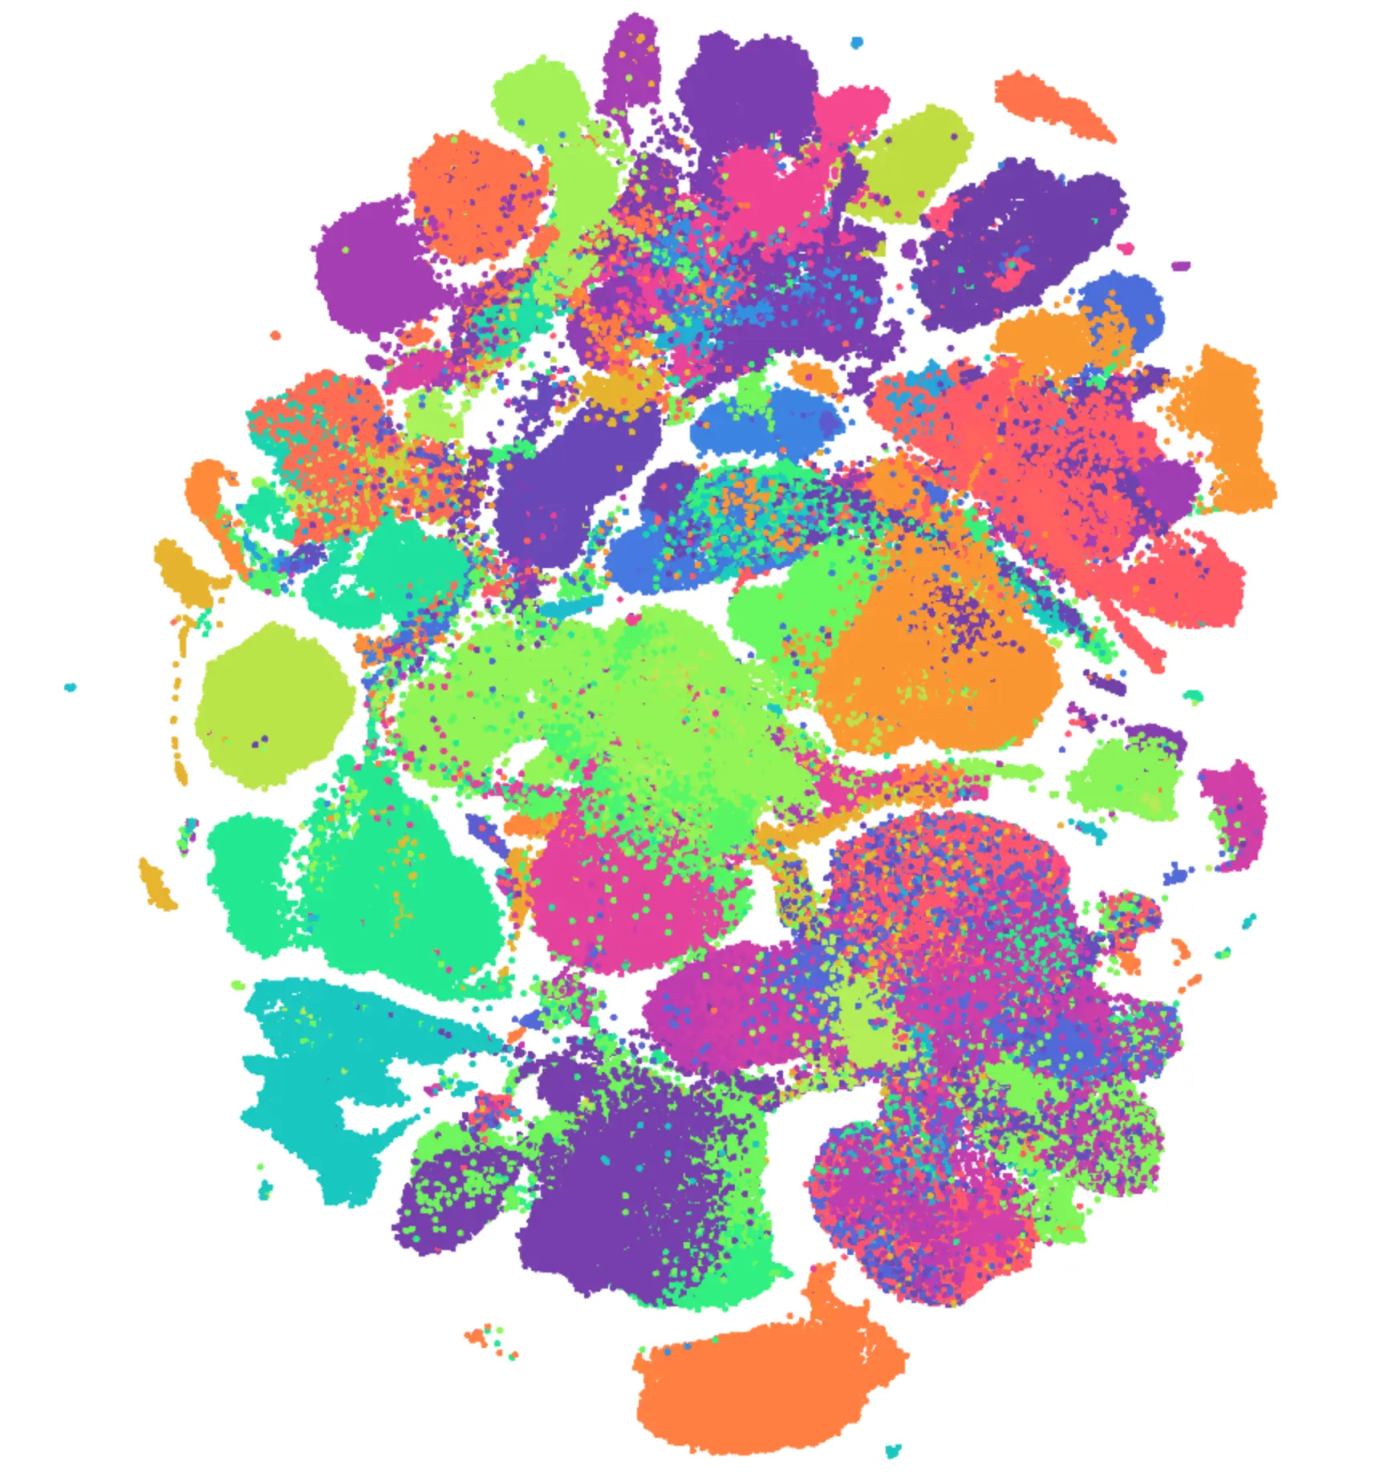
CellXGene: A Powerful Tool for Spatial Transcriptomics + Interfacing CellXGene with Seurat
Dennis Hamrick

Slide 2
What is CellXGene?
CellXGene is an open source tool for publishing and analysing spatial and single-cell datasets.
CellXGene allows you to easily access and analyze many public spatial transcriptomics datasets, as well as many single-cell transcriptomics datasets.
You can also use CellXGene for publishing and graphically interacting with your own data.

Slide 3

Code on Github for this workflow
github.com/dennishamrick/UTSW-CellXGene-Seurat-Toolkit
Or just go to github.com/dennishamrick and access the repo there!

Slide 4
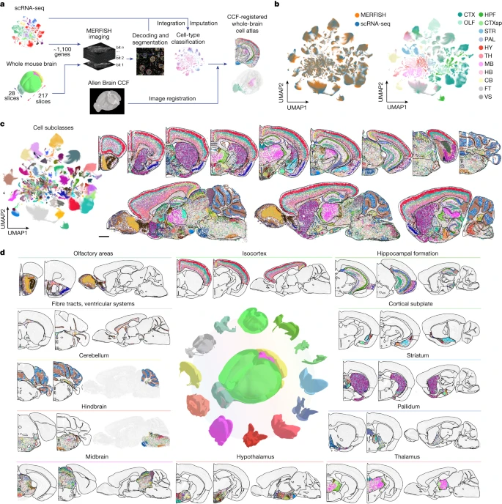
What datasets are available?
In 2023, Zhang et al. published a MERFISH atlas of the whole mouse brain.
Data is available on CellXGene.
1124 genes, markers for most major cell types.
Several different brains available (coronal/sagittal sections)

Slide 5
What datasets are available?
This talk will use one brain from the Zhang dataset as an example, but there are thousands of other datasets available on CellXGene.
Every major organ
Developmental atlases
Various species/model organisms

Slide 6

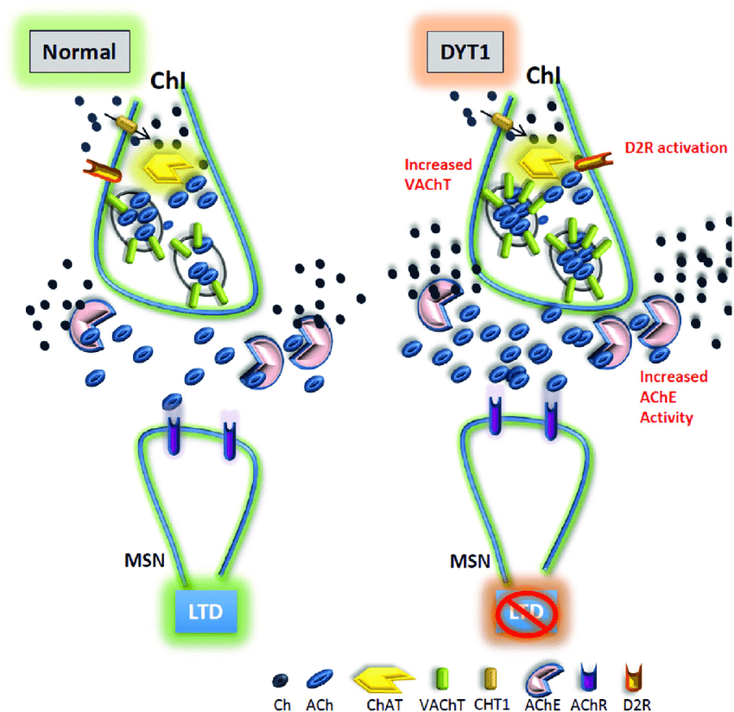
What questions can we answer with CellXGene/the Zhang Atlas?
DYT1 dystonia is a congenital movement disorder characterized by involuntary twisting movements.
A mutation in the gene TorsinA is implicated. This mutation causes death of cholinergic neurons in the striatum.
This effect is not complete – some striatal cholinergic neurons are unaffected, and there are spatial (specifically, dorsal-ventral) biases for which cells die.
Striatal cholinergic neurons are a very small population (a few thousand cells). This makes it difficult to study them and their heterogeneity.
Question: Is there spatial heterogeneity in the transcriptomic profile of Chat+ cells?

Slide 7
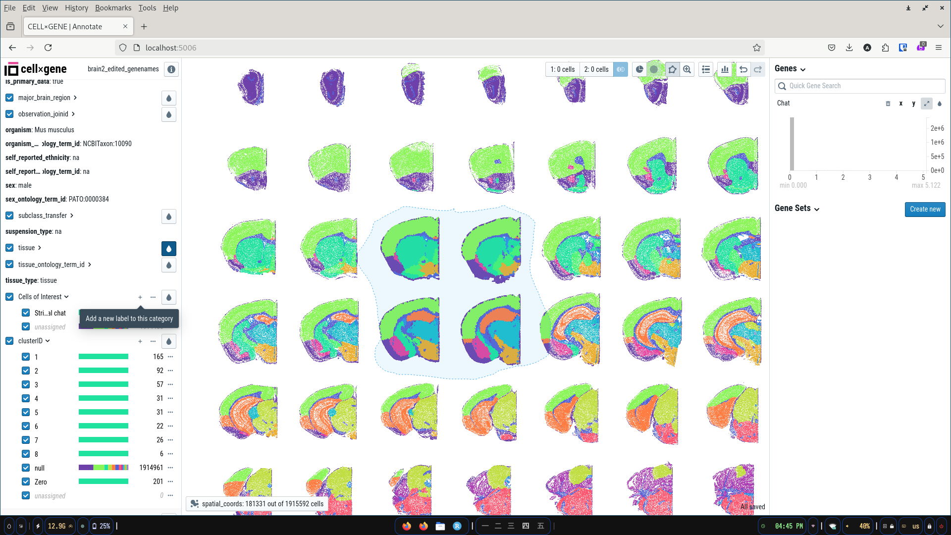
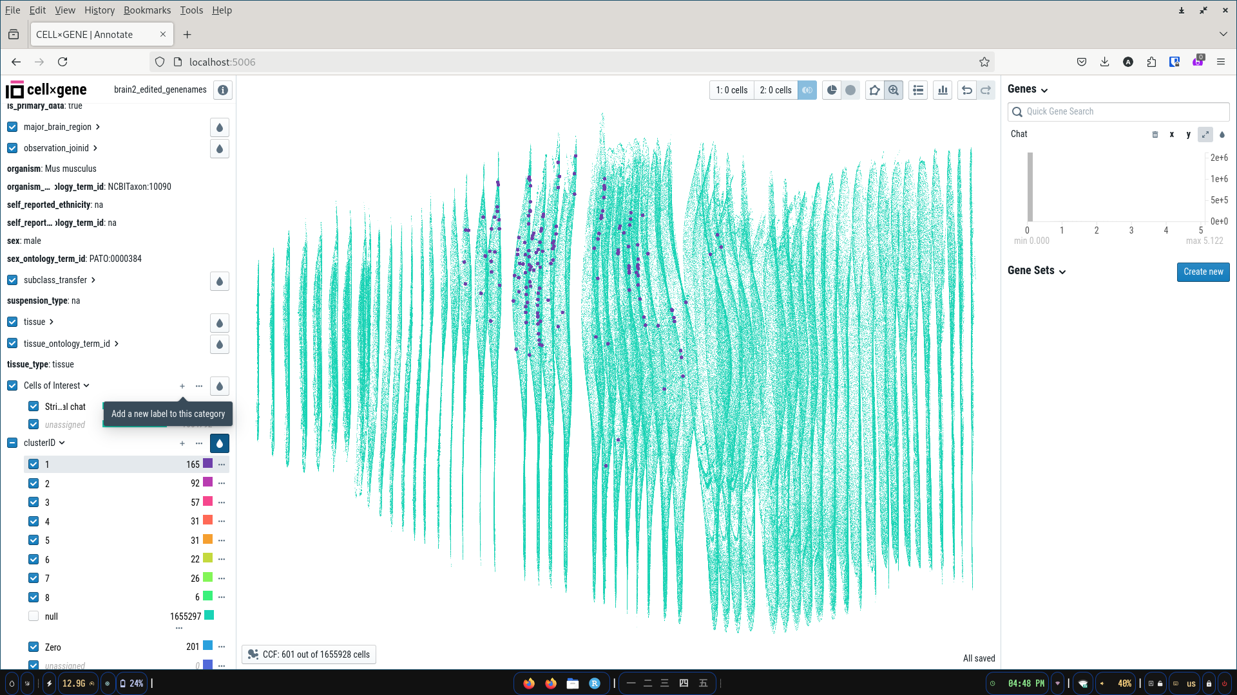
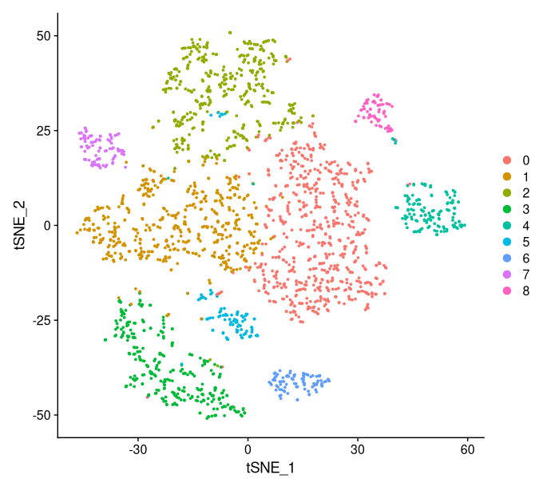
Interfacing CellXGene With Seurat
Port back into CxG, visualize spatial arrangement of clusters
Port CxG data into Seurat, interact with it as a Seurat object
Identify and select cells of interest in CxG

Slide 8
Step By Step - Preparation
1. Download needed programs: Python, Anaconda, R, Rstudio.
2. Create an anaconda environment with cellxgene and other needed packages.
3. Install Seurat and other needed R Packages listed in generic_cellxgene.R.
4. Download CellXGene dataset of interest.
4b. Change gene names if needed using edit_gene_names.py.

Slide 9
Step By Step - Analysis
1. Find your group of interest – select cells by location, gene expression, or some other variable.
2. Use merge_annotations.py to add your selections into the CellXGene file.
3. Import your CellXGene .h5ad file with annotations into RStudio using generic_cellxgene.R and convert it into a Seurat object.
4. Analyze with Seurat workflow.
5. Use generic_cellxgene.R to make a annotations CSV from your clusters.
6. Visualize your clusters in CellXGene.

Slide 10
Demo

Slide 11
Thank you for listening!
Special thanks to Pool Lab members and Dauer Lab members.

